Slide 1
CRIB TD model development
June 19, 2026

Slide 2
General process
In CRIB, higher score = more vulnerable
Get average CRIB score for each species
*IN SIM…
Sample CRIB score for each run of simulation
Rescale CRIB scores so that species are comparable
Logit transform (allows for winners (> 0.5) and losers (<0.5)
Divide by maximum value (everyone is a loser, but some lose more than others)
Wrote that this should be both in my notes, but ran into infinity during logit transform after rescaling – misunderstanding?
Chose by how much you want community to decline per year
Partition community decline among stocks based on CRIB scores:
Adjusted RP = RP - ((p/100)*RP*CRIB)

Slide 3
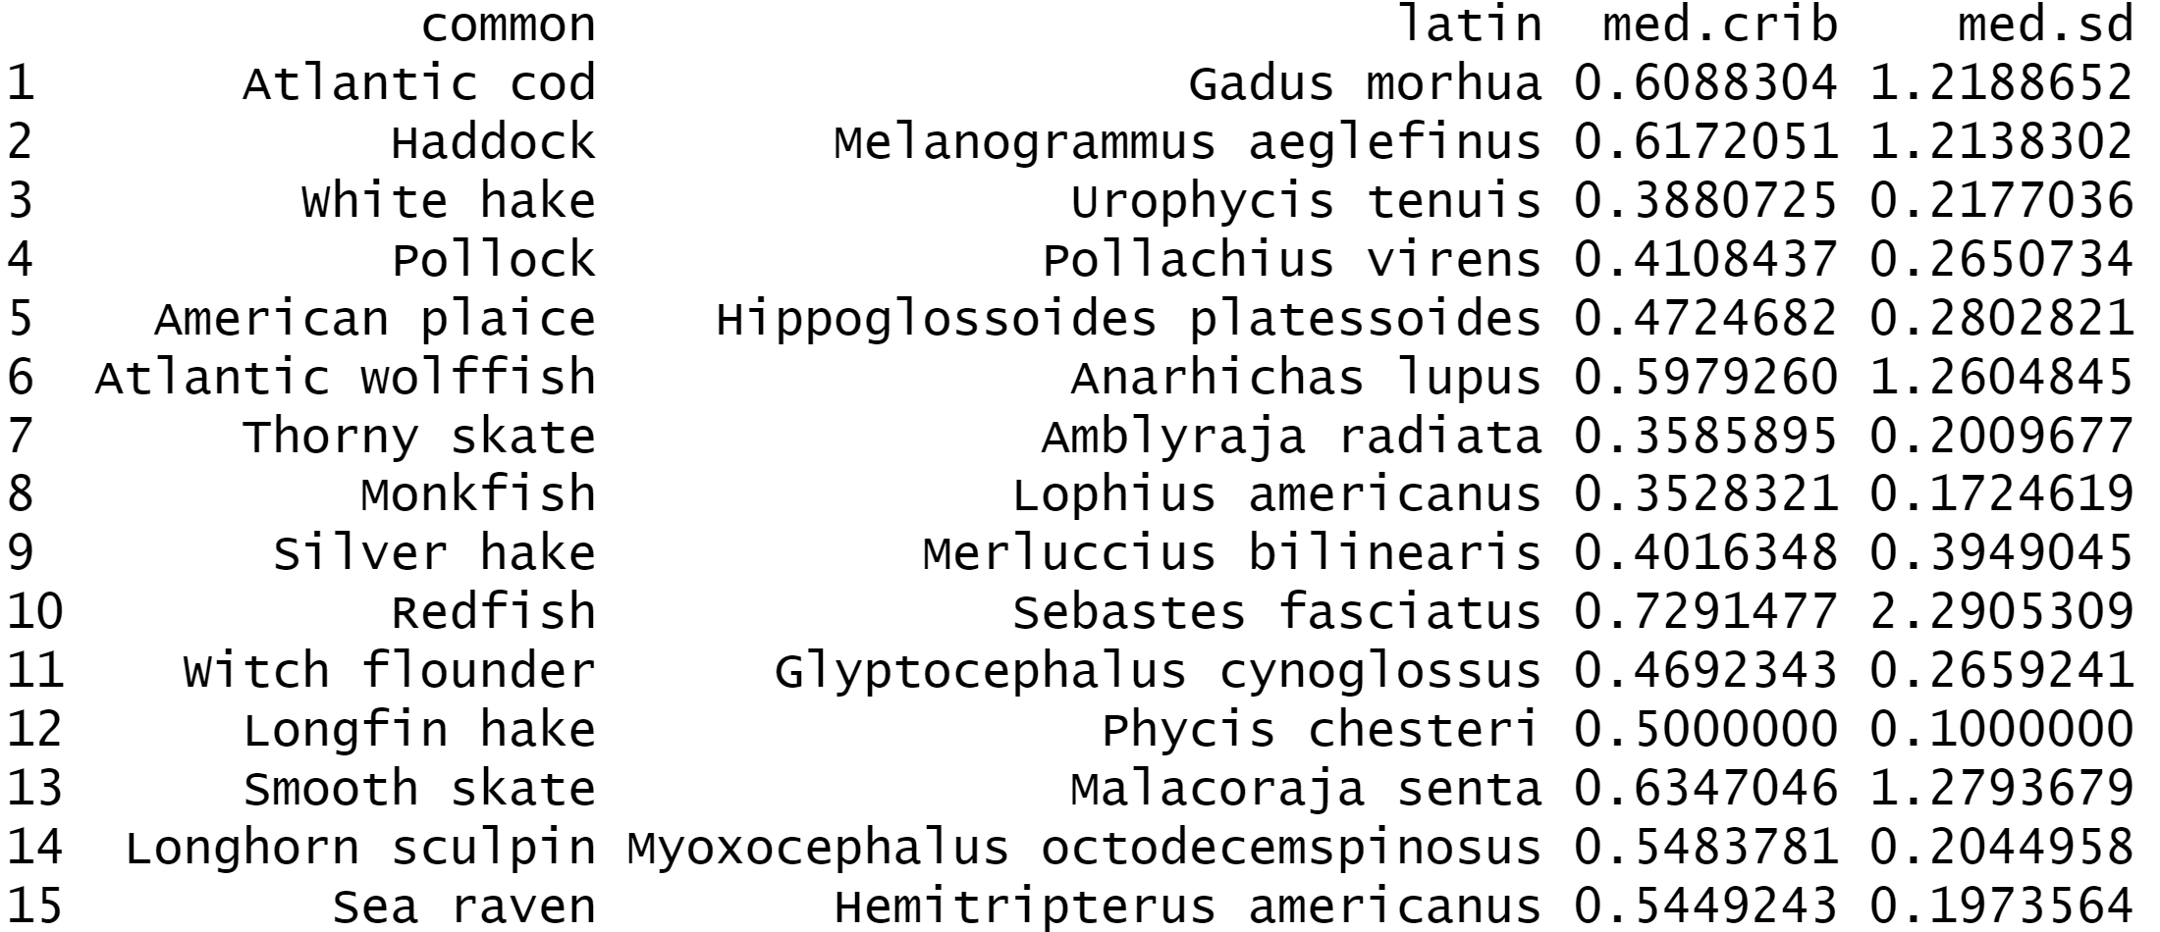
Get average CRIB score for each species
Longfin hake has no CRIB scores
Distribution of CRIB scores either right- or left-skewed for all species, so went with median instead of mean
Some SDs were > 1
Notes:
Highest is redfish, lowest is thorny skate/monkfish

Slide 4
Sample CRIB score for each run of simulation (building in uncertainty)
Sampling from random lognormal
Is this right approach? Should SDs be logged too (broke sampling)?
Notes:
Blue is inputted median, boxplot is simulated

Slide 5
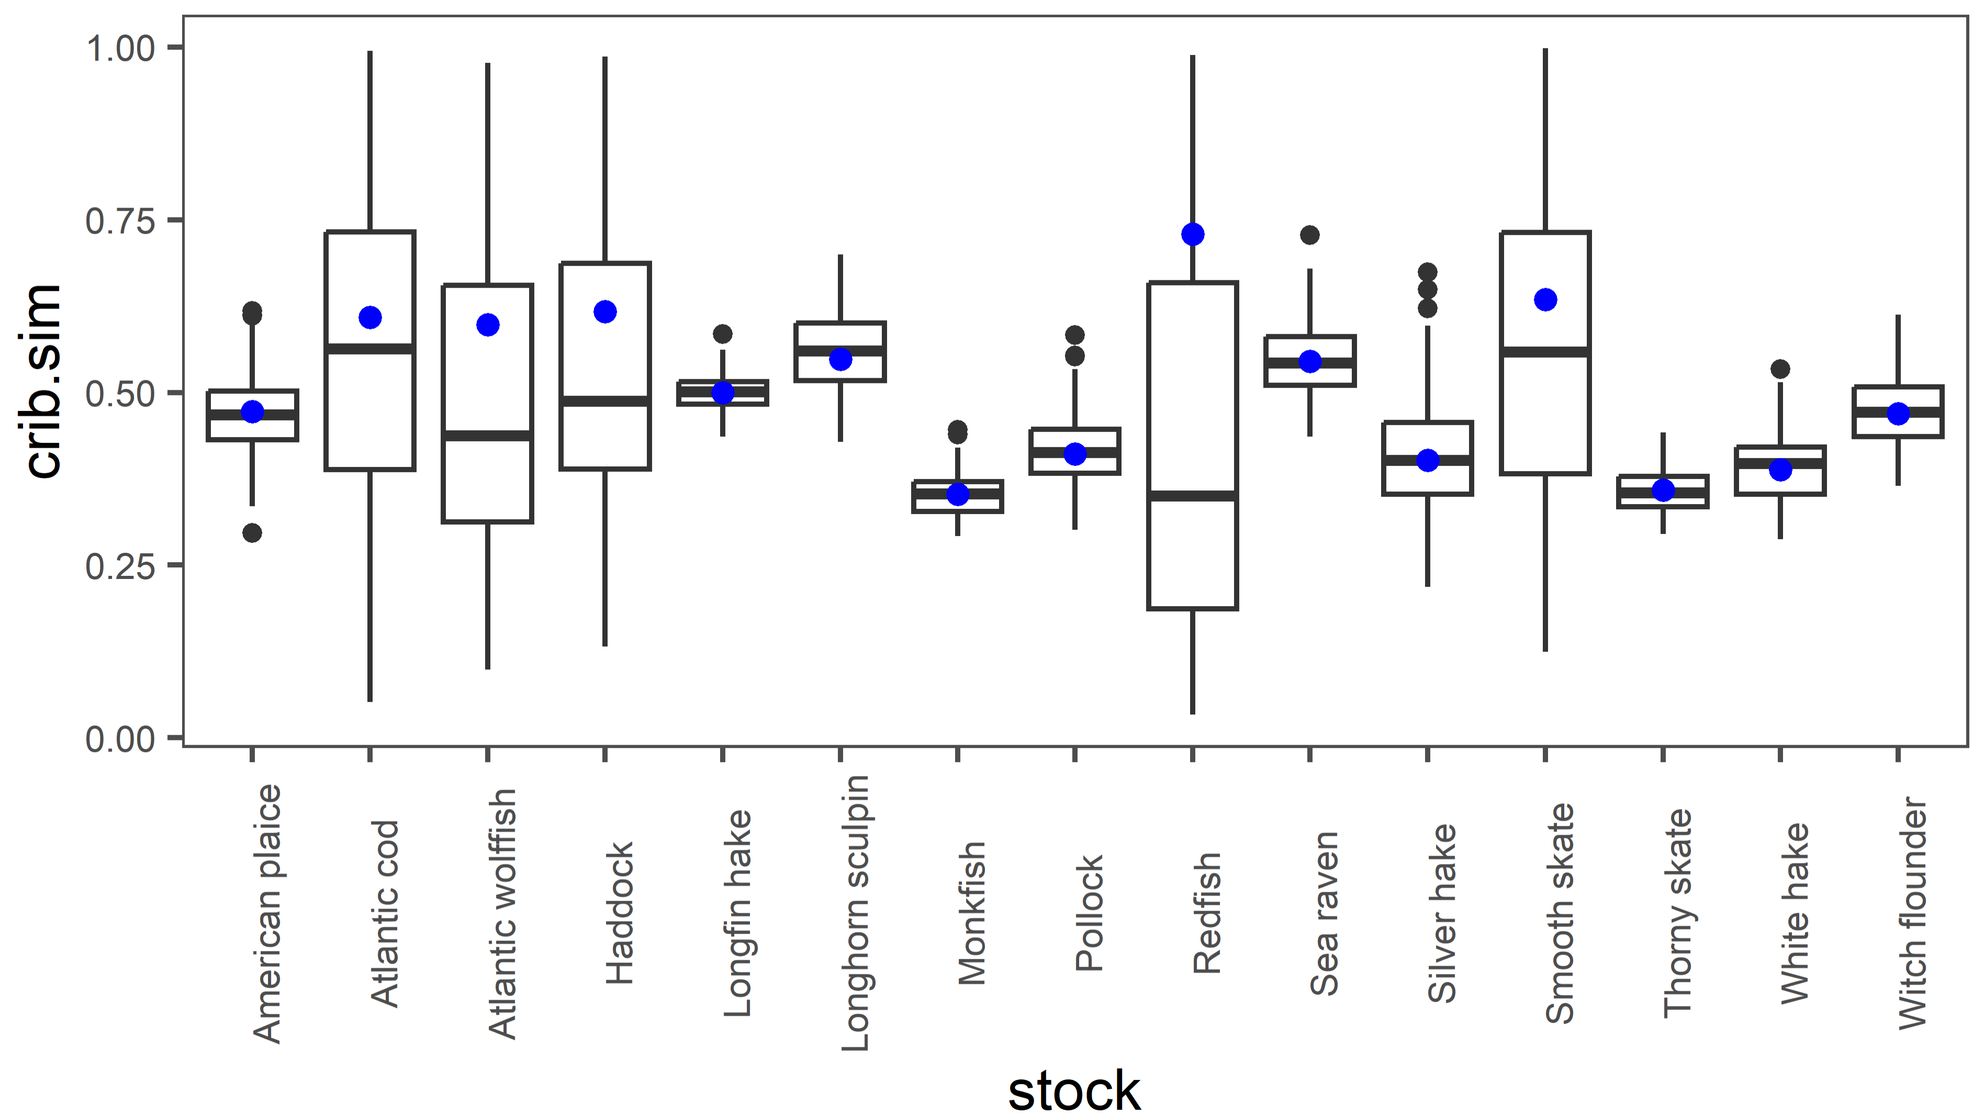
Sample CRIB score for each run of simulation (building in uncertainty)
Some SDs were > 1
Tried resampling, upping number of sims to 100 and dividing SD by 2 – no luck
Notes:
Blue is inputted median, boxplot is simulated

Slide 6
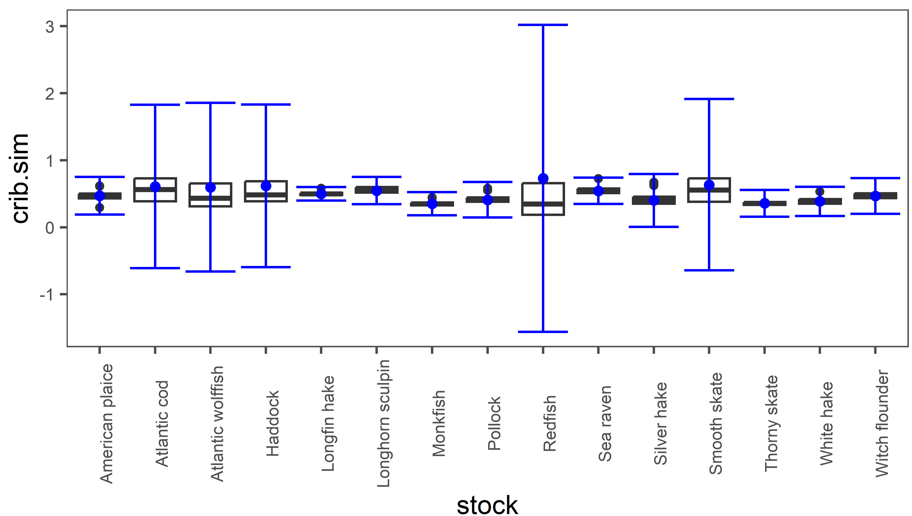

Slide 7
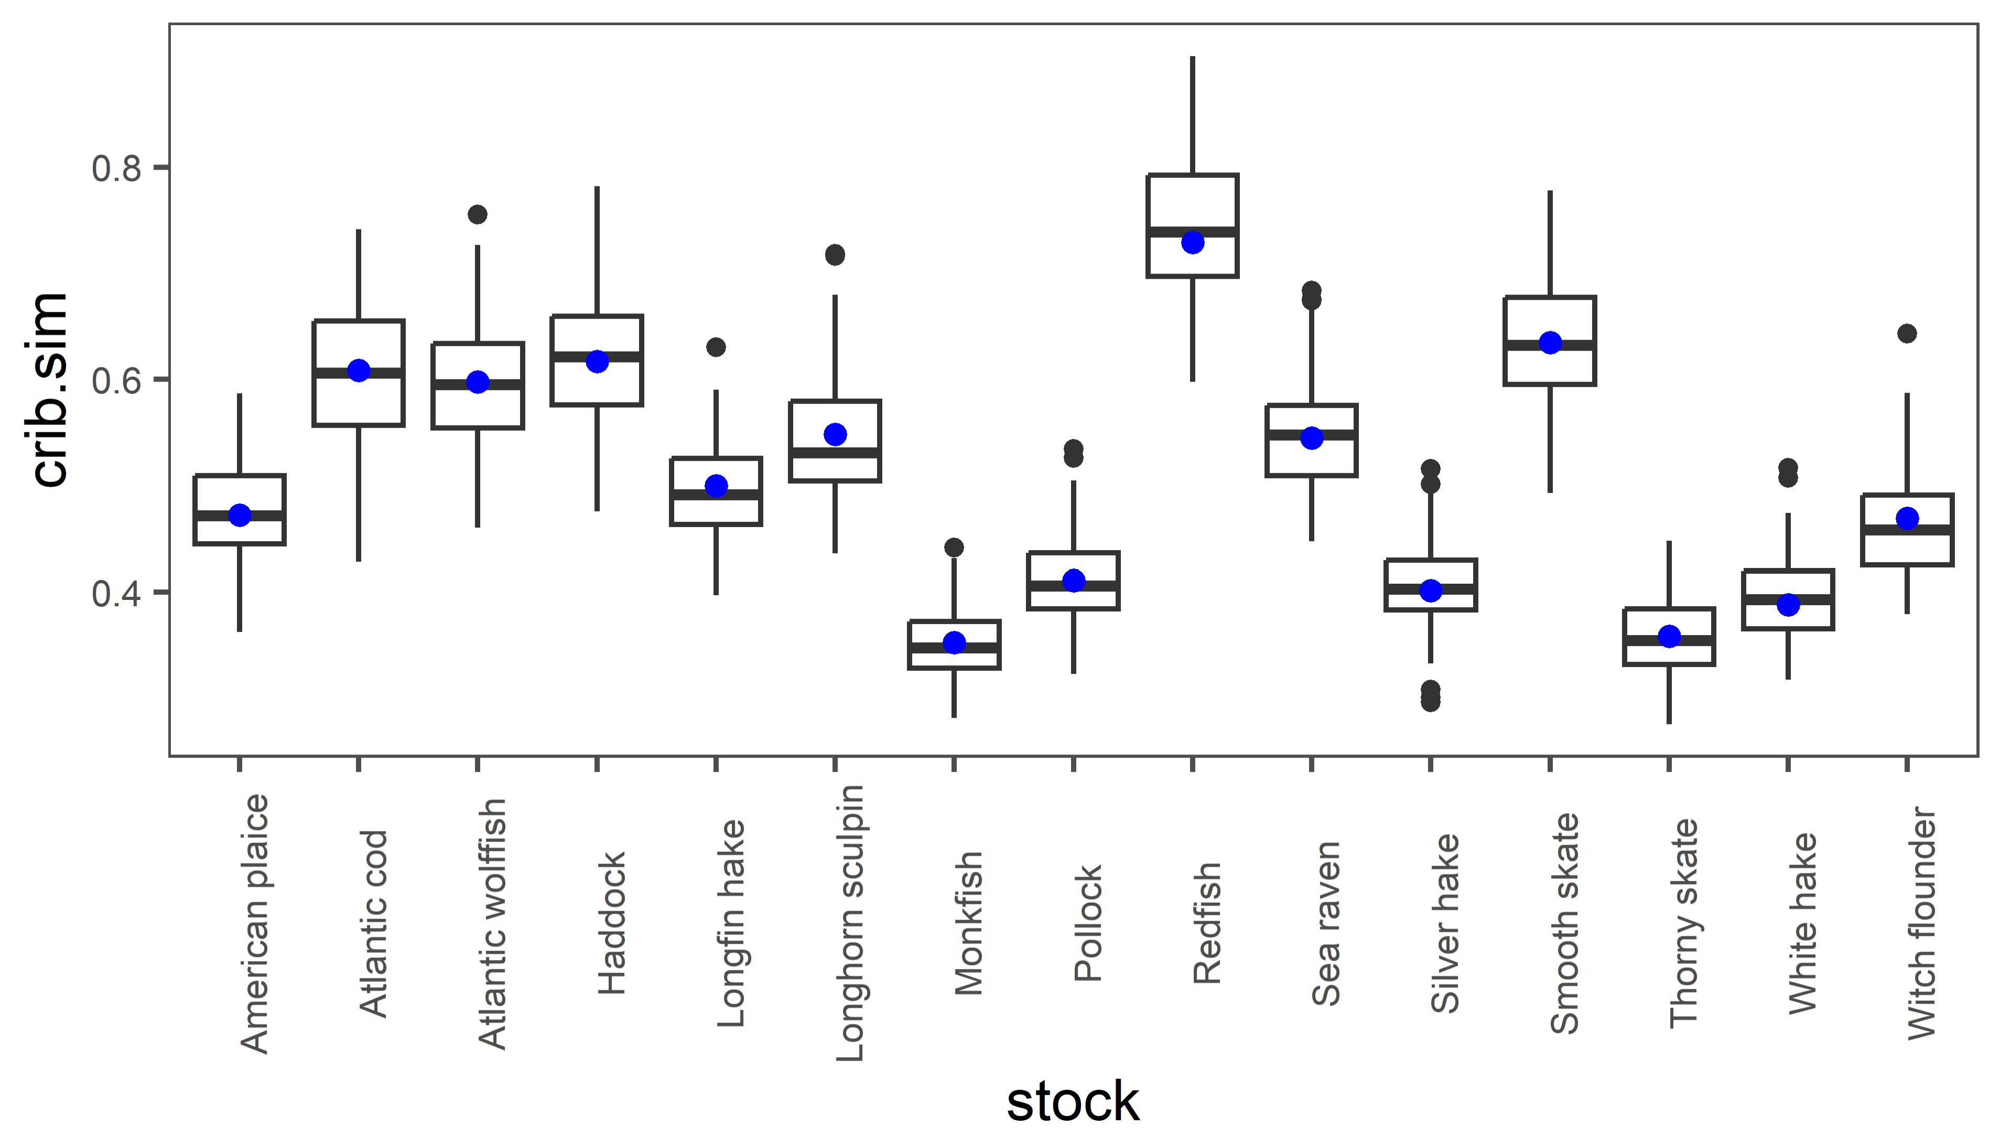
Sample CRIB score for each run of simulation (building in uncertainty)
Setting all SDs to 0.1 (no resampling)
Notes:
Blue is inputted median, boxplot is simulated
Still seems to cover patterns in inputs (species with overlapping SDs still overlap)

Slide 8
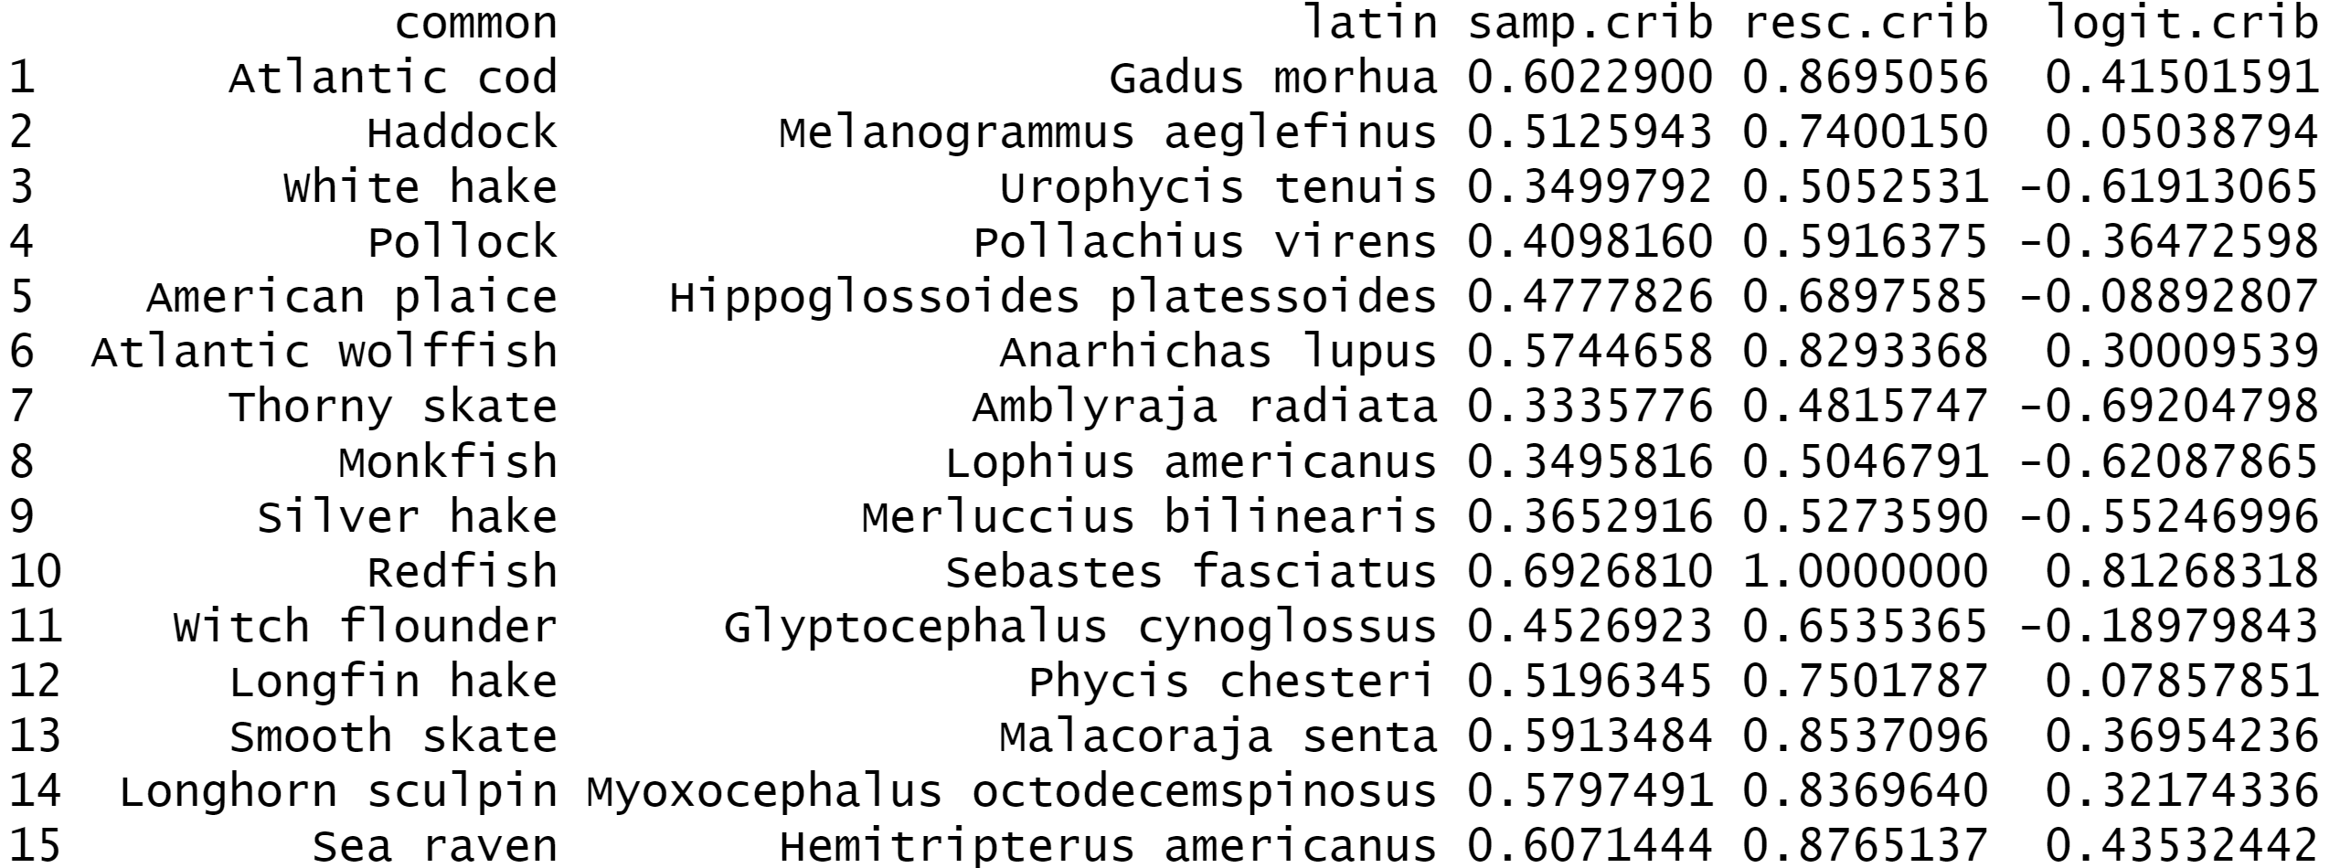
Rescale CRIB scores so that species are comparable
Currently done inside sim – better to rescale outside?
Notes:
Example from 1 sim
In logit, ones below 0.5 will be negative (in eqn, subtracting a negative so that means space is added to these stocks)

Slide 9
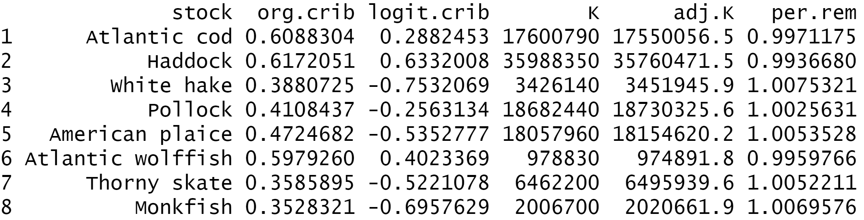
Partition community decline among stocks based on CRIB scores
Adjusted RP = RP - ((p/100)*RP*CRIB)
Logit version
A p = 1 gives 99.8% of FG left, p=2 gives 99.7%, etc. (consistent pattern of -0.1%)
Notes:
Example from 1 sim, larges, year 1

Slide 10
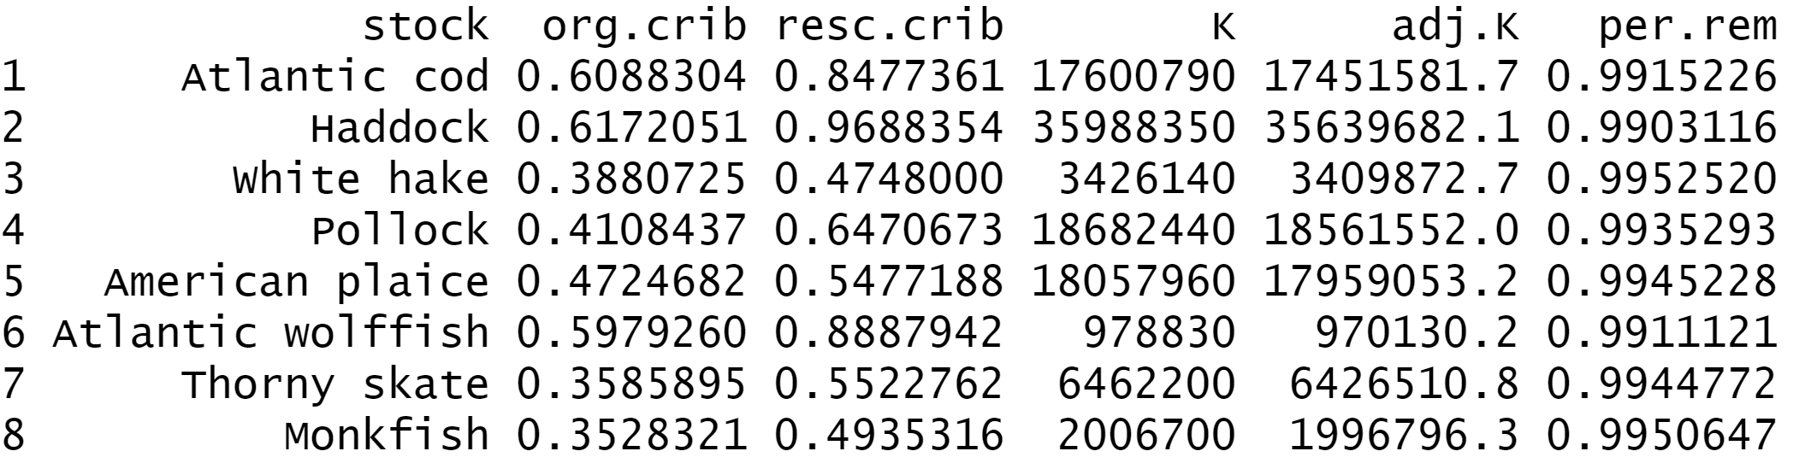
Partition community decline among stocks based on CRIB scores
Adjusted RP = RP - ((p/100)*RP*CRIB)
Maximum version
A p = 1 gives 99.2% of FG left, p=2 gives 98.5%, etc. (consistent pattern, -0.7%)
Notes:
Example from 1 sim, larges, year 1

Slide 11
Partition community decline among stocks based on CRIB scores
Env deg set by user is maximum potential decline in stock resources
Change in resource pool could be less, but can never exceed env deg
Does this make sense?
Notes:
Example from 1 sim, larges, year 1

Slide 12
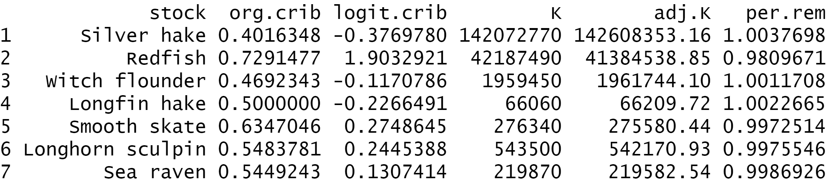
Partition community decline among stocks based on CRIB scores
Adjusted RP = RP - ((p/100)*RP*CRIB)
Logit version
Same behaviour as larges in terms of FG
Notes:
Example from 1 sim, mediums, year 1

Slide 13
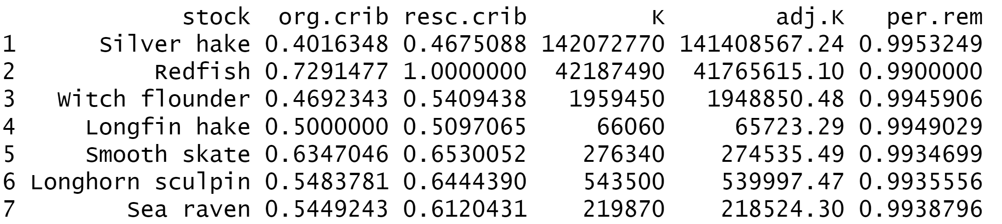
Partition community decline among stocks based on CRIB scores
Adjusted RP = RP - ((p/100)*RP*CRIB)
Maximum version
FG declines by 0.5% as p increases
Notes:
Example from 1 sim, mediums, year 1

Slide 14
Runs - logit
Notes:
100 sims, no fish
Cod and haddock should be doing more similar things to redfish – think our density dependence rules are too strong?

Slide 15
Runs - logit
Notes:
100 sims, no fish
Cod and haddock should be doing more similar things to redfish – think our density dependence rules are too strong?

Slide 16
Runs - logit
Notes:
100 sims, no fish
Cod and haddock should be doing more similar things to redfish – think our density dependence rules are too strong?

Slide 17
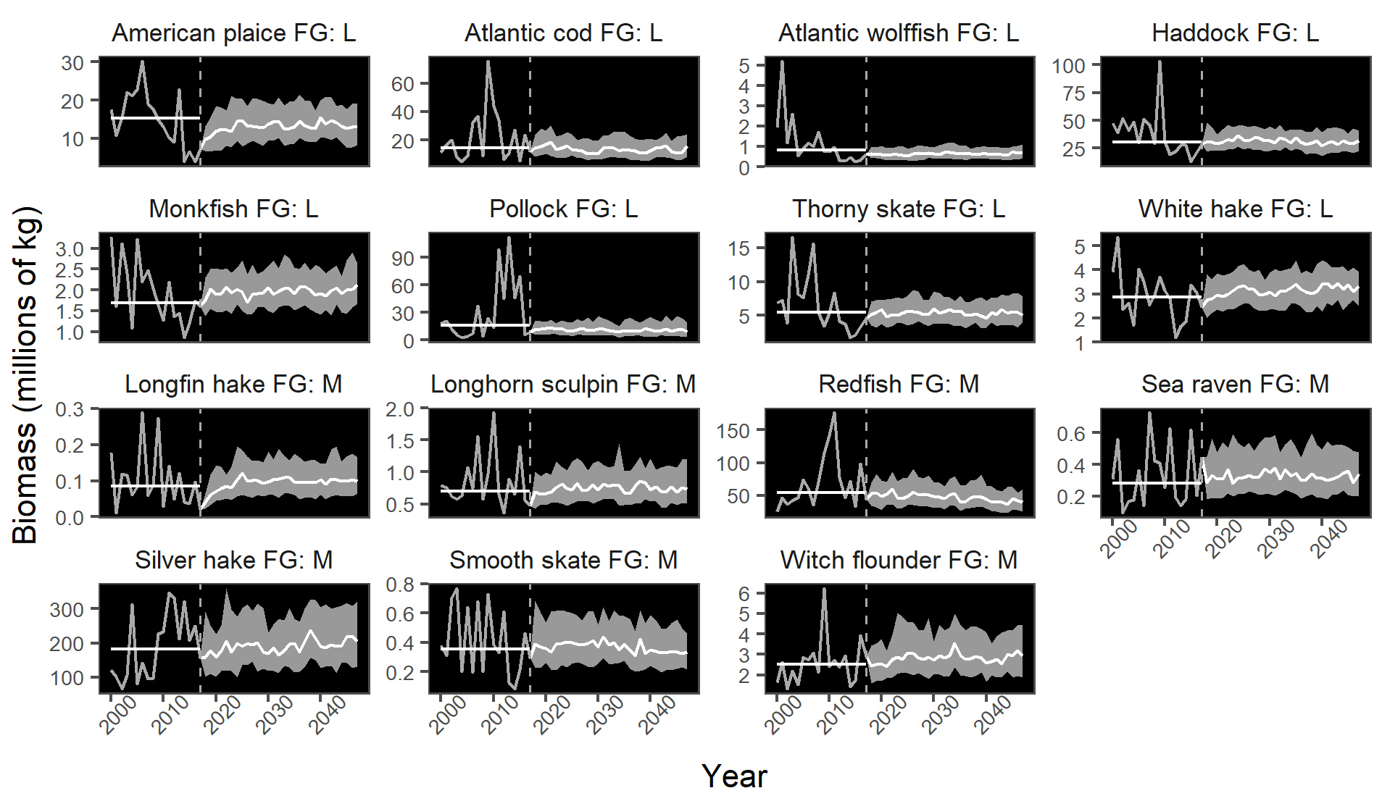
Runs - maximum
Notes:
100 sims, no fish, p = 1
Everyone looks too happy

Slide 18
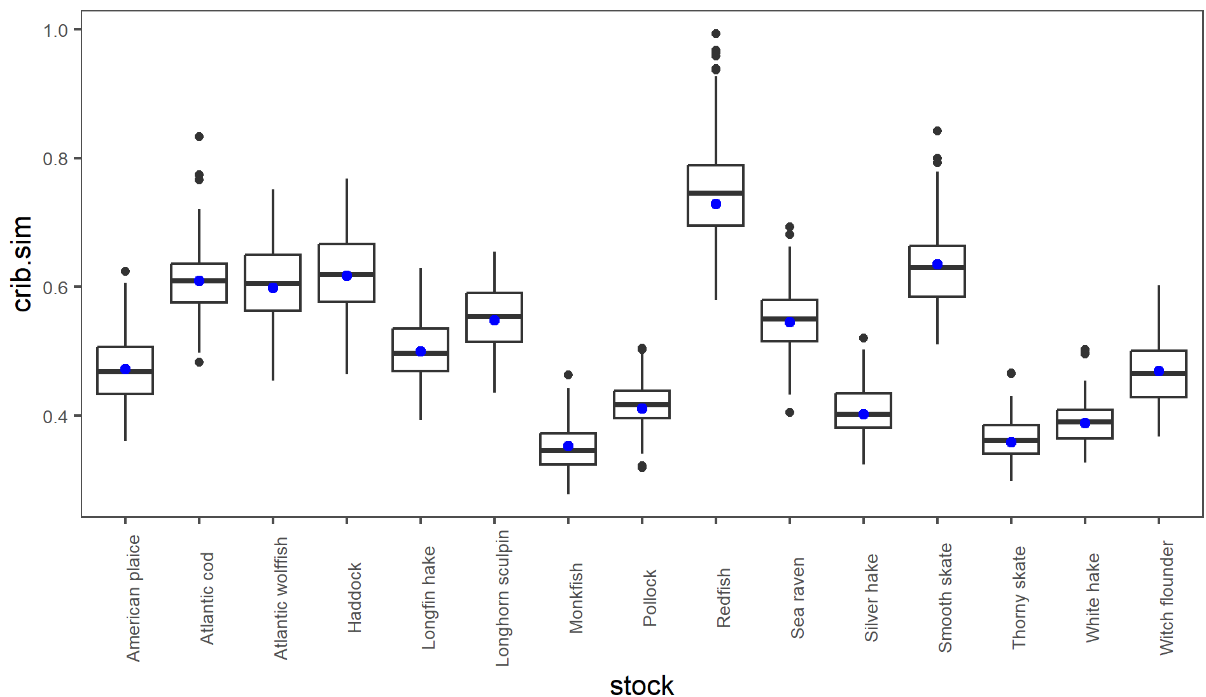
Runs - maximum
Notes:
CRIB scores are predicted well

Slide 19
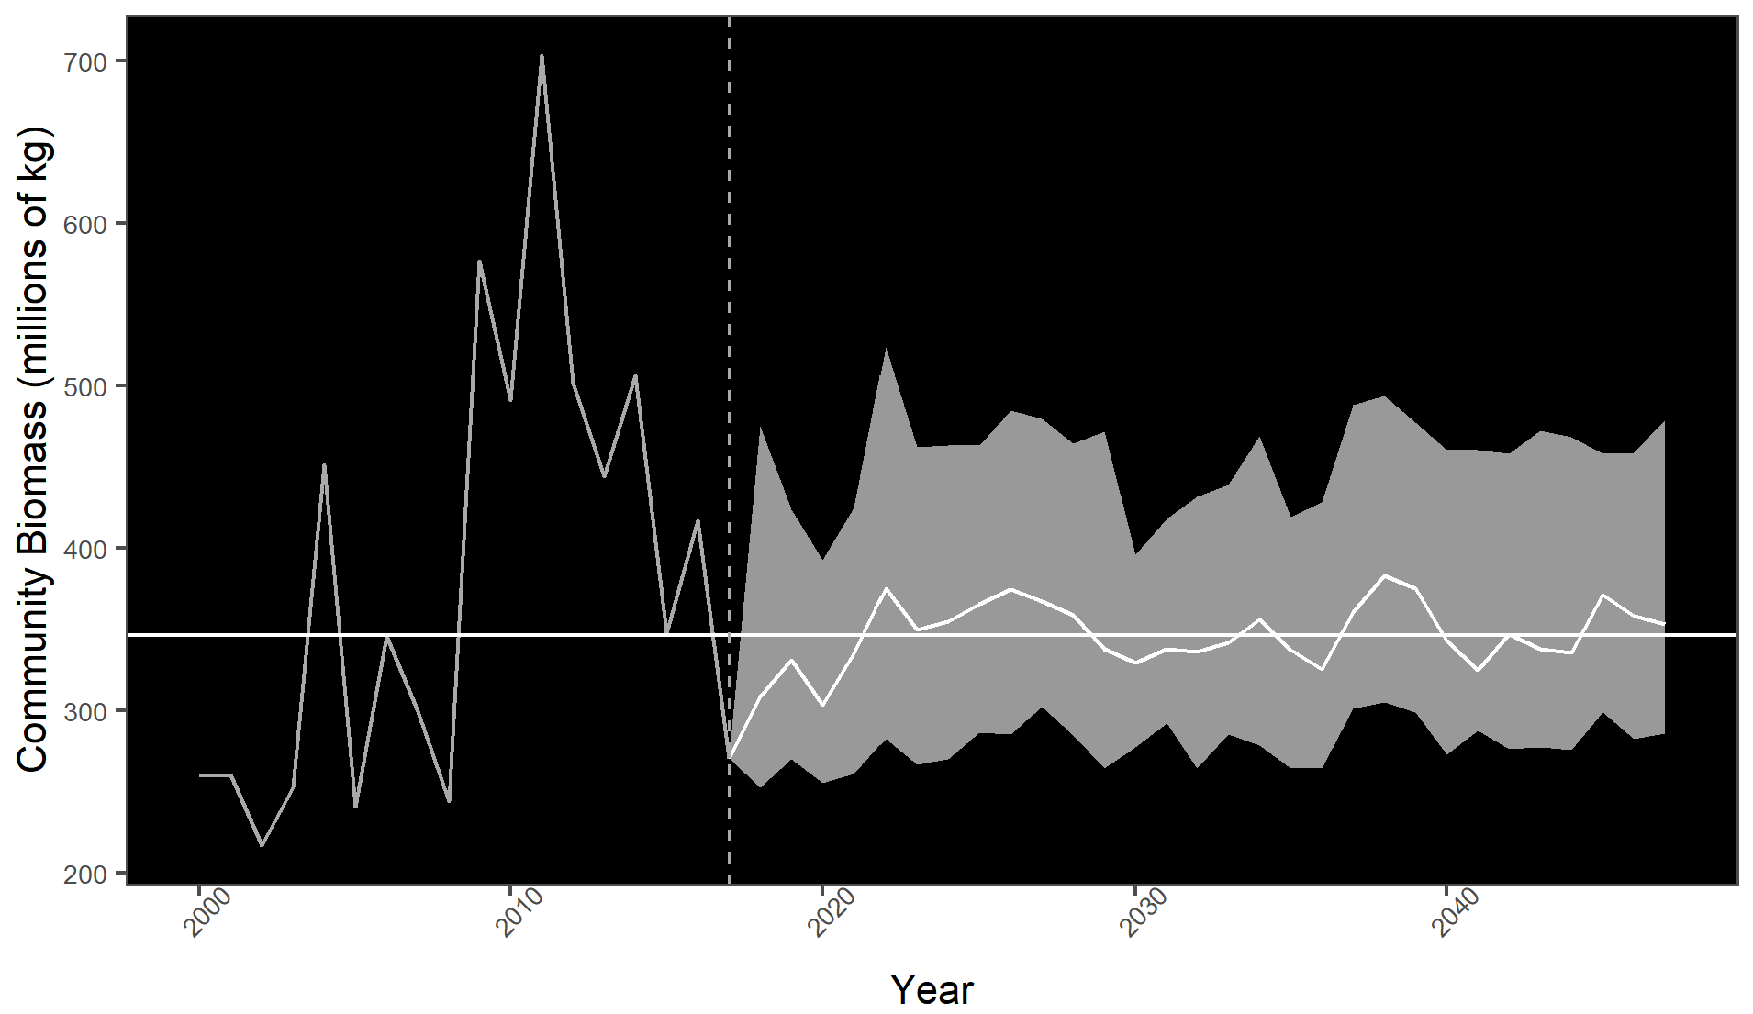
Runs - maximum
Notes:
Community should be suffering more

Slide 20
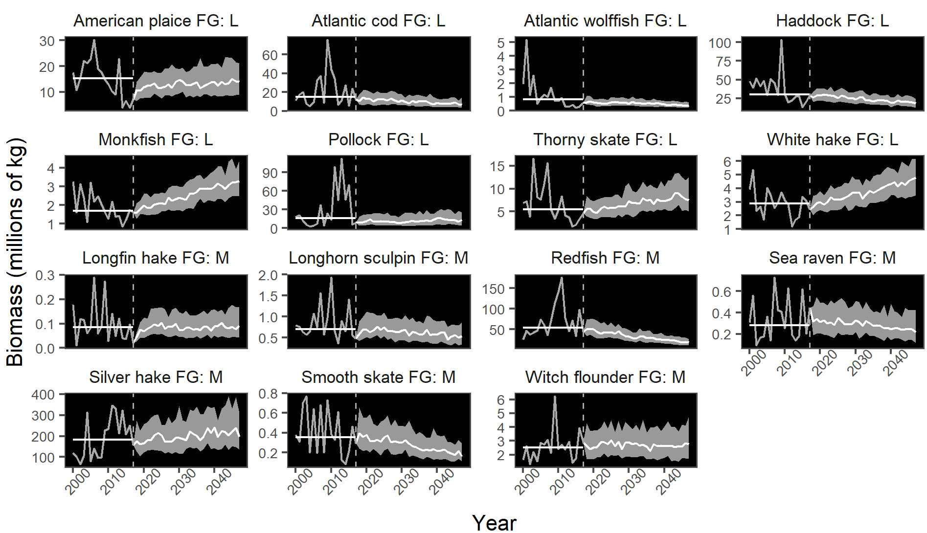
Runs – maximum 2
Notes:
100 sims, no fish, p = 10
Interesting!

Slide 21
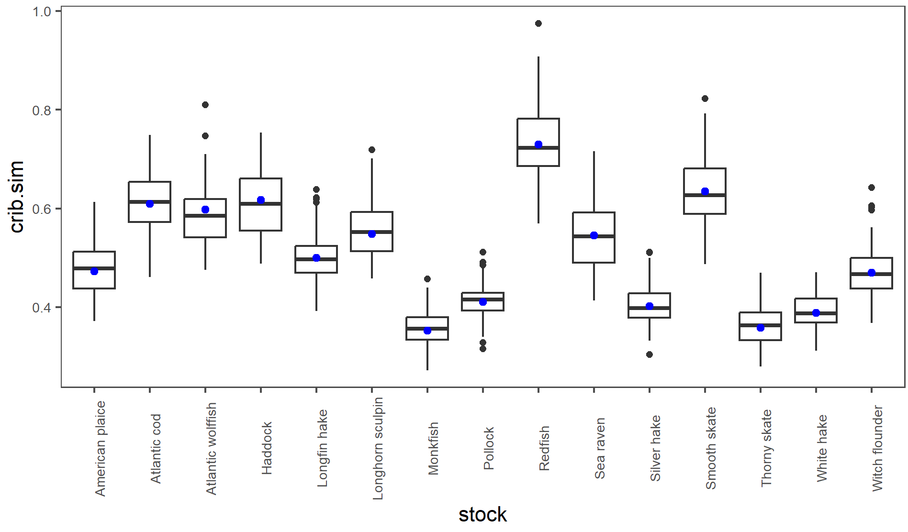
Runs – maximum 2
Notes:
CRIB scores are predicted well

Slide 22
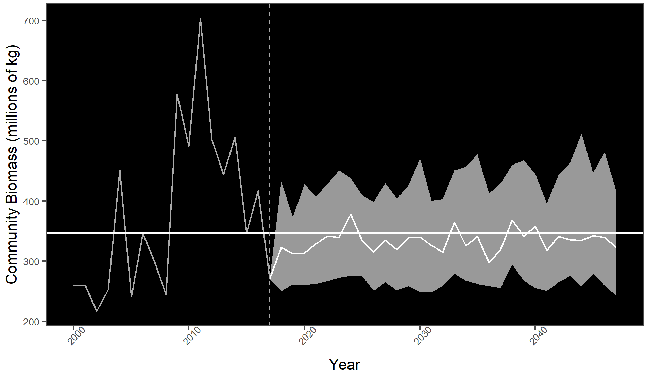
Runs – maximum 2
Notes:
Verrrry interesting! May need a penalty on community size as well?

